Slide 1
Book Tracking Application
Chetan Sharma→ A20391333
Bin Sun →A20376746
Rachna Bafna → A20342050
Thomas Latrofa → A20367335
Chen Gong →A20379606

Slide 2

Book Tracking Made Easy

Slide 3


Requirements
Book tracking system
Allows students to borrow paper packed or hardcover books
Allows access to central repository containing ebooks
Allows access to central repository having research papers
Easy to use and navigate
Tracks student records

Slide 4
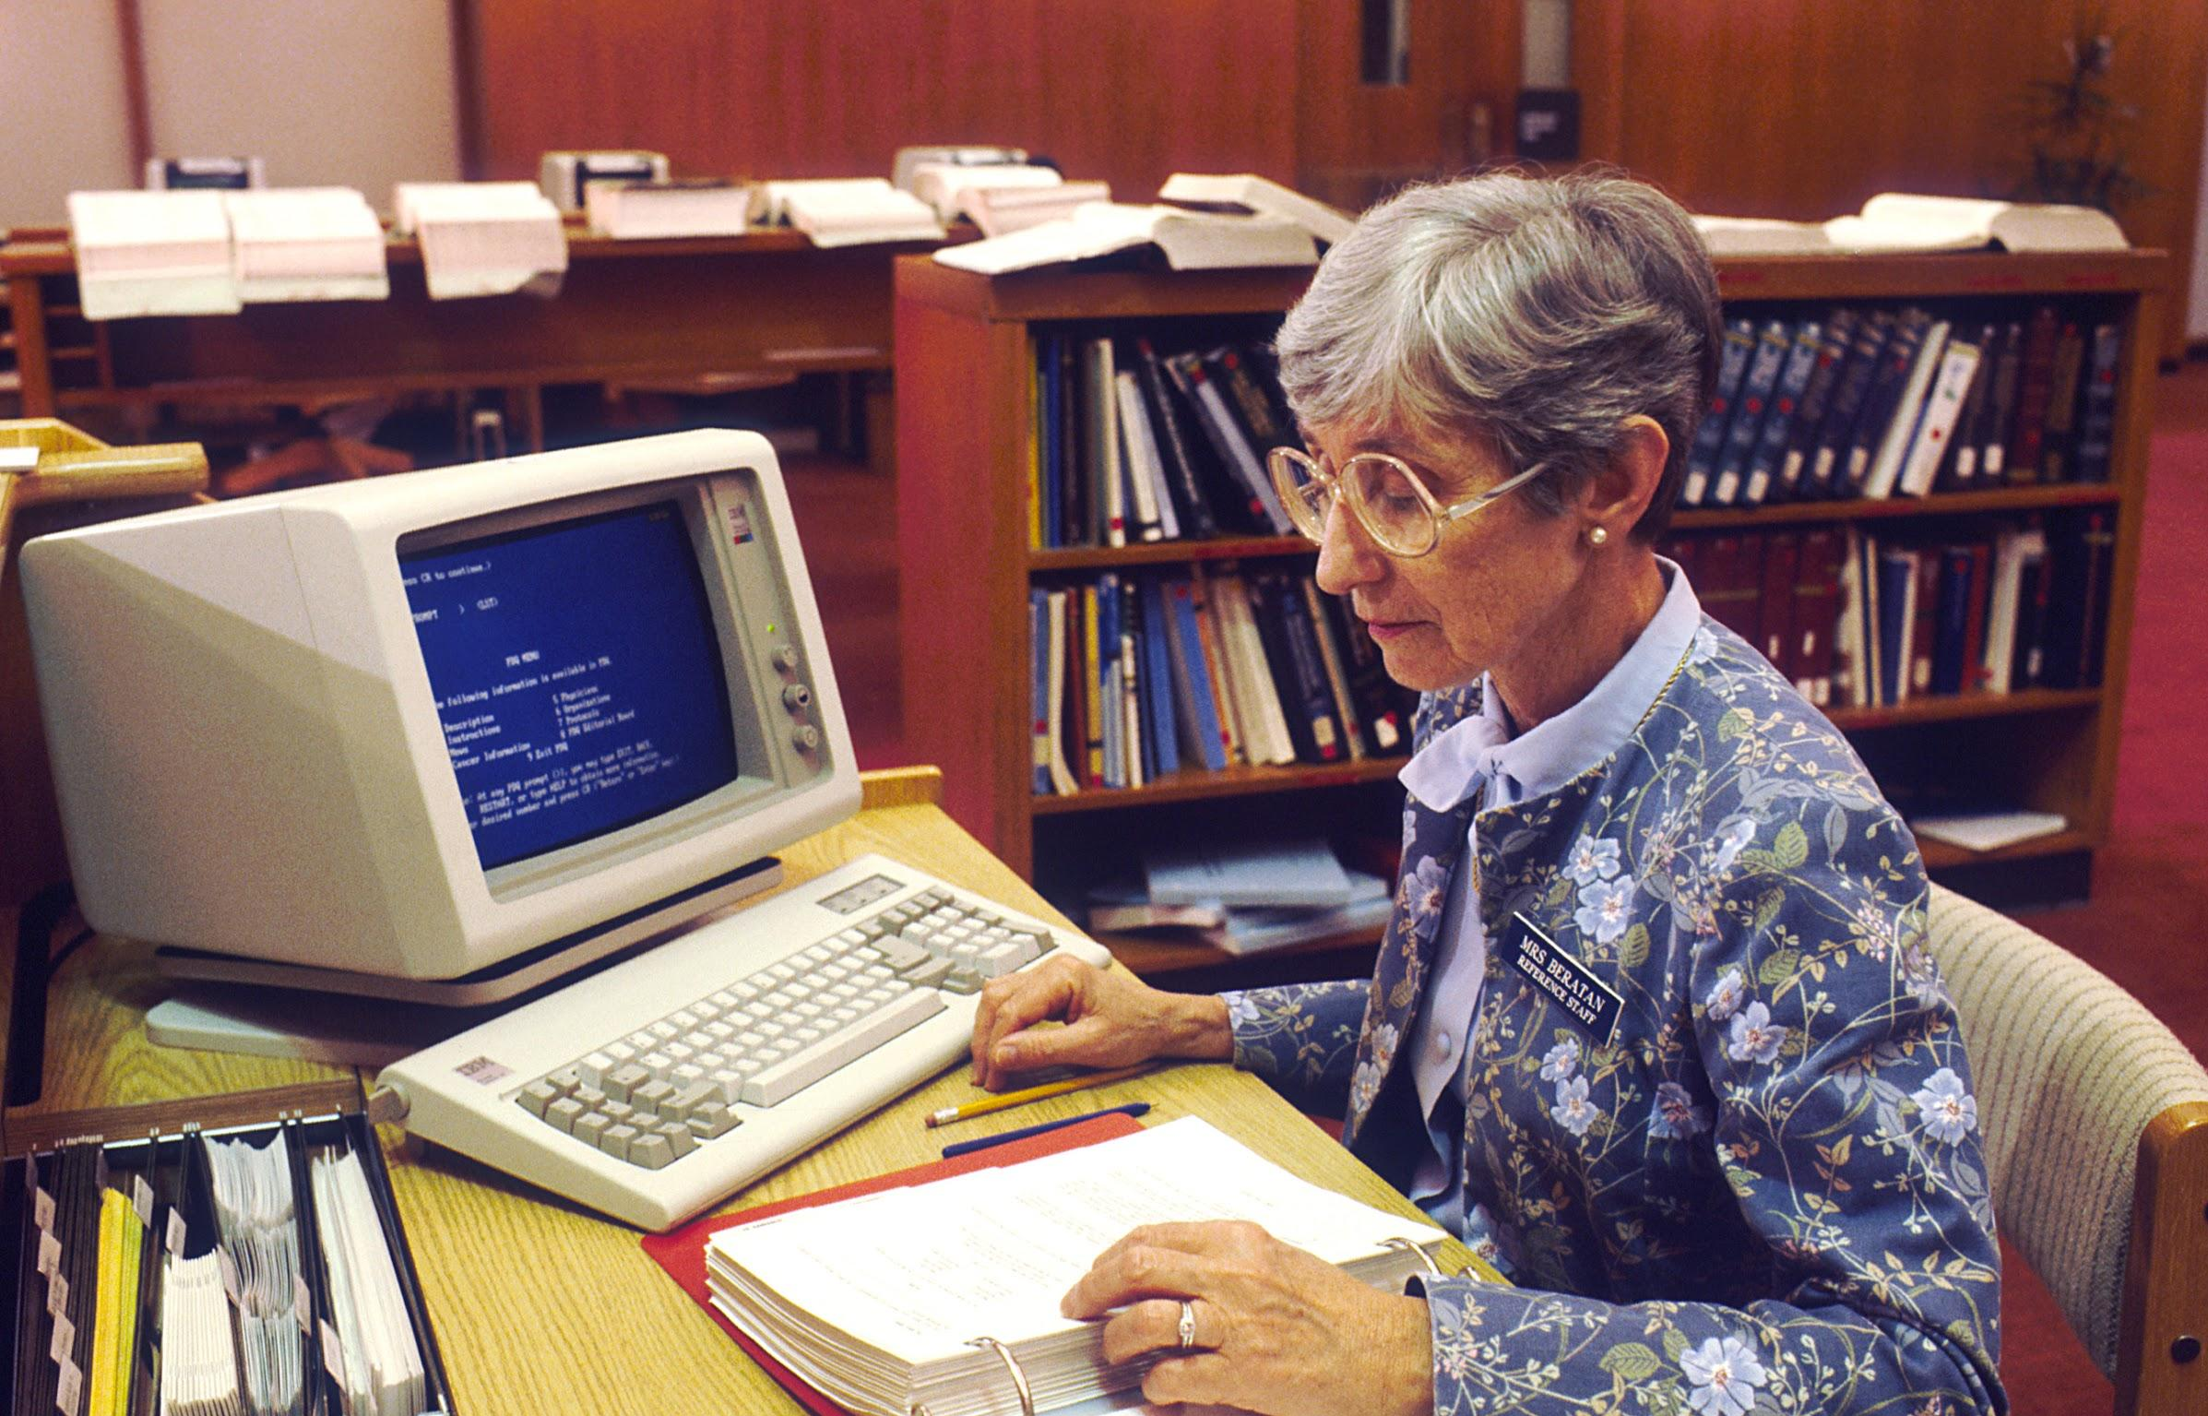

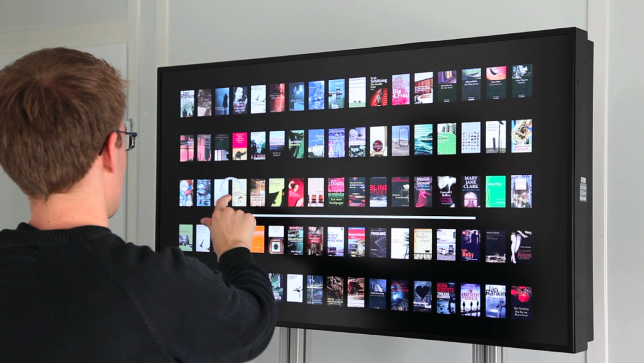
Who Will be Using This?
Students - Limited User
Teachers - Privileged Users
Librarians - Administrators

Slide 5
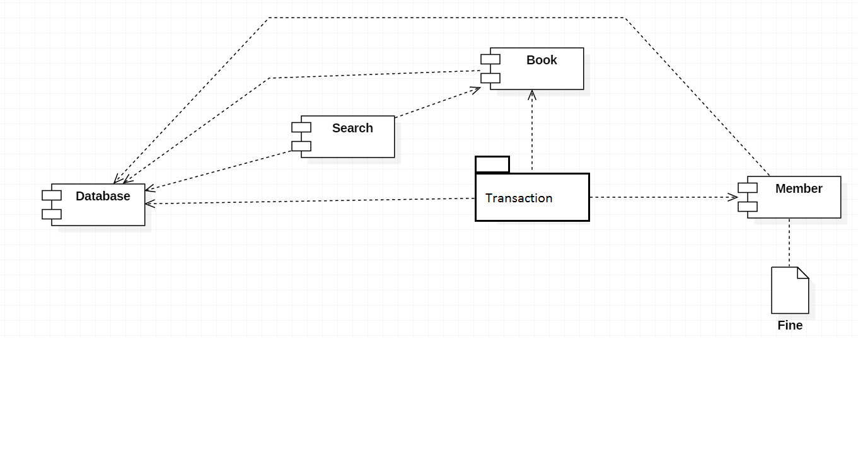
System Design

Slide 6
What Students Can Do
Create user account
Reserve Books
Notified when book is available
Access digital copies of books
Search for paper packed or ebooks
View user details
Pay fine

Slide 7
What Teachers Can Do
Create Teacher account
Have more privileges in terms of
number of books borrowed
The duration for which book can be borrowed
Suggest books on portal to students

Slide 8
What Administrator Can Do
Add new book details
Remove already existing books - Outdated
Edit book count
Update student accounts
Run fine calculation jobs
Order new books
Update book inventory

Slide 9
Hardware and Software Requirements
Web browser :Chrome, IE, Safari and Mozilla
Operating Systems : Mac OS, Windows, Ubuntu
Internet: 2G, 3G, LTE support, 1-100Mbps
Mobile Operating System: Windows, IOS, Android

Slide 10
Testing
Manual Testing
Automated Test cases
Performance Testing
Regression Testing

Slide 11
Performance and Security
Fast Response Time
Responsive application under heavy load
High throughput
Username/Password Based Authentication
Security Questions for failed login attempts
Check for DOS attacks

Slide 12
User Interface
Intuitive User Interface
Easy to use
Easy to navigate
Quick load time
Lazy loading - Allows quick loading with low internet speed
Lightweight - So can be accessed with low internet speeds

Slide 13
Prototype Demo

